Slide 1

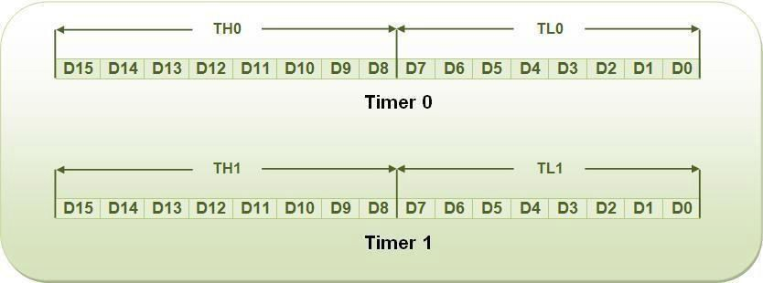
Timers and Counters
Introduction
Timers/Counters are used generally for
Time reference
Creating delay
Wave form properties measurement
Periodic interrupt generation
Waveform generation

Slide 2
8051 has two timers, Timer 0 and Timer 1.
Timer in 8051 is used as timer, counter and baud rate generator. Timer always counts up irrespective of whether it is used as timer, counter, or baud rate generator: Timer is always incremented by the microcontroller. The time taken to count one digit up is based on master clock frequency.
If Master CLK=12 MHz,
Timer Clock frequency = Master CLK/12 = 1 MHz Timer Clock Period = 1 micro second
This indicates that one increment in count will take 1 micro second.
The two timers in 8051 share two SFRs (TMOD and TCON) which control the timers, and each timer also has two SFRs dedicated solely to itself (TH0/TL0 and TH1/TL1).

Slide 3
The following are timer related SFRs in 8051.
SFR Name Description SFR Address
TH0 Timer 0 High Byte 8Ch
TL0 Timer 0 Low Byte 8Ah
TH1 Timer 1 High Byte 8Dh
TL1 Timer 1 Low Byte 8Bh
TCON Timer Control 88h
TMOD Timer Mode 89h

Slide 4
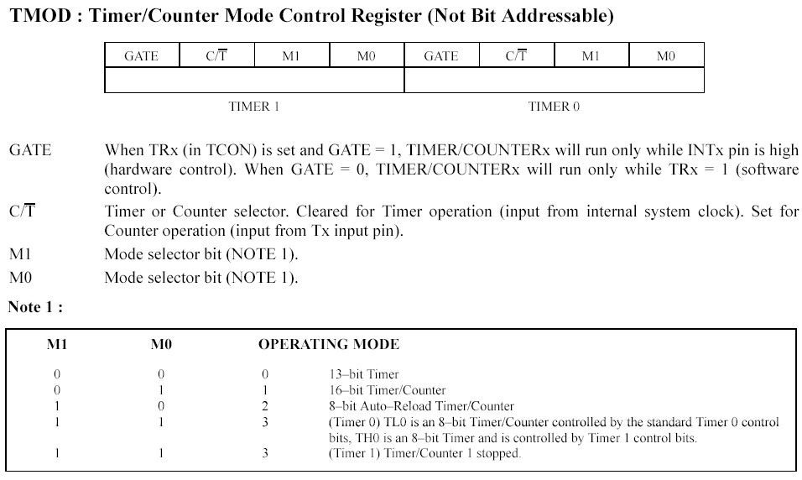
TMOD Register

Slide 5
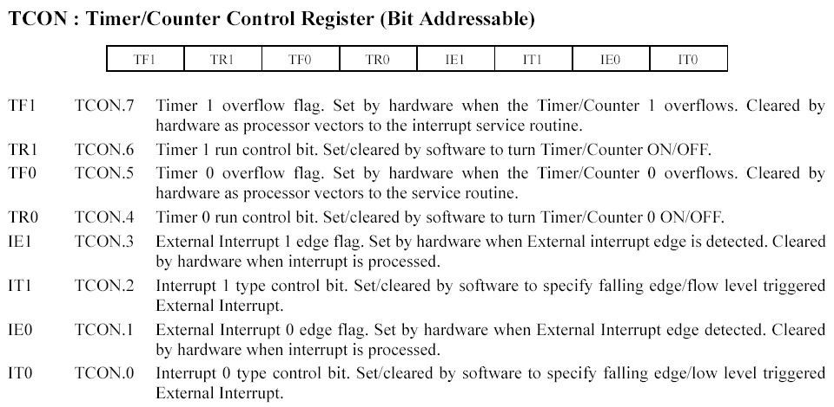
TCON Register

Slide 6
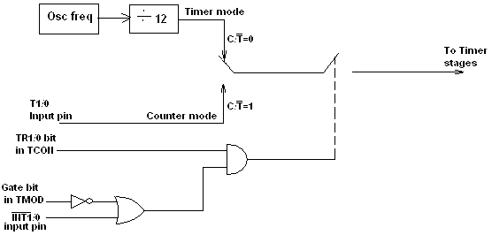
Timer/ Counter Control Logic.

Slide 7

TIMER MODES
Timers can operate in four different modes. They are as follows.
Timer Mode-0. In this mode, the timer is used as a 13-bit UP counter as follows.
Fig. Operation of Timer on Mode-0
The lower 5 bits of TLX and 8 bits of THX are used for the 13 bit count. The upper 3 bits of
TLX are ignored. When the counter rolls over from all 0's to all 1's, TFX flag is set and an interrupt is generated. The input pulse is obtained from the previous stage. If TR1/0 bit is 1 and Gate bit is 0, the counter continues counting up. If TR1/0 bit is 1 and Gate bit is 1, then the operation of the counter is controlled by input. This mode is useful to measure the width of a given pulse fed to input.

Slide 8

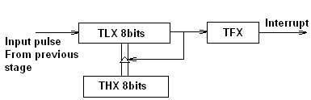
Timer Mode-1. This mode is similar to mode-0 except for the fact that the Timer operates in 16- bit mode.
Fig: Operation of Timer in Mode 1
Timer Mode-2 (Auto-Reload Mode). This is a 8 bit counter/timer operation. Counting is performed in TLX while THX stores a constant value. In this mode when the timer overflows i.e. TLX becomes FFH, it is fed with the value stored in THX. For example, if we load THX with 50H then the timer in mode 2 will count from 50H to FFH. After that 50H is again reloaded. This mode is useful in applications like fixed time sampling.
Fig: Operation of Timer in Mode 2

Slide 9


Timer Mode-3. Timer 1 in mode-3 simply holds its count. The effect is same as setting TR1=0. Timer0 in mode-3 establishes TL0 and TH0 as two separate counters.
Fig: Operation of Timer in Mode 3
Control bits TR1 and TF1 are used by Timer-0 (higher 8 bits) (TH0) in Mode-3 while TR0 and TF0 are available to Timer-0 lower 8 bits (TL0).

Slide 10
Programming 8051 Timers in Assembly
In order to program 8051 timers, it is important to know the calculation of initial count value to be stored in the timer register. The calculations are as follows.
In any mode, Timer Clock period = 1/Timer Clock Frequency.
= 1/(Master Clock Frequency/12)
Mode 1 (16 bit timer/counter)
Value to be loaded in decimal = 65536 – (Delay Required/Timer clock period) Convert the answer into hexadecimal and load onto THx and TLx register. (65536D = FFFFH+1)
Mode 0 (13 bit timer/counter)
Value to be loaded in decimal = 8192 – (Delay Required/Timer clock period) Convert the answer into hexadecimal and load onto THx and TLx register. (8192D = 1FFFH+1)

Slide 11
c. Mode 2 (8 bit auto reload)
Value to be loaded in decimal = 256 – (Delay Required/Timer clock period) Convert the answer into hexadecimal and load onto THx register. Upon starting the timer this value from THx will be reloaded to TLx register.
(256D = FFH+1)

Slide 12
Steps for programming timers in 8051
Mode 1:
Load the TMOD value register indicating which timer (0 or 1) is to be used and which timer mode is selected.
Load registers TL and TH with initial count values.
Start the timer by the instruction “SETB TR0” for timer 0 and “SETB TR1” for timer 1.
Keep monitoring the timer flag (TF) with the “JNB TFx, target” instruction to see if it is raised. Get out of the loop when TF becomes high.
Stop the timer with the instructions “CLR TR0” or “CLR TR1”, for timer 0 and timer 1, respectively.
Clear the TF flag for the next round with the instruction “CLR TF0” or “CLR TF1”, for timer 0 and timer 1, respectively.
Go back to step 2 to load TH and TL again.

Slide 13
Steps for programming timers in 8051
Mode 0:
The programming techniques mentioned here are also applicable to counter/timer mode 0. The only difference is in the number of bits of the initialization value.
Mode 2:
1. Load the TMOD value register indicating which timer (0 or 1) is to be used; select timer mode 2.
Load TH register with the initial count value. As it is an 8-bit timer, the valid range is from 00 to FFH. Start the timer.
Keep monitoring the timer flag (TFx) with the “JNB TFx, target” instruction to see if it is raised. Get out of the loop when TFx goes high.
Clear the TFx flag.
Go back to step 4, since mode 2 is auto-reload.

Slide 14
1. Write a program to continuously generate a square wave of 2 kHz frequency on pin P1.5 using timer 1. Assume the crystal oscillator frequency to be 12 MHz.
The period of the square wave is T = 1/(2 kHz) = 500 μs. Each half pulse = 250 μs. The value n
for 250 μs is: 250 μs /1 μs = 250
65536 - 250 = FF06H.
TL = 06H and TH = 0FFH.
MOV TMOD, #10 ; Timer 1, mode 1
AGAIN: MOV TL1, #06H ; TL0 = 06H
MOV TH1, #0FFH ; TH0 = FFH
SETB TR1 ; Start timer 1
BACK: JNB TF1, BACK ; Stay until timer rolls over
CLR TR1 ; Stop timer 1
CPL P1.5 ; Complement P1.5 to get Hi, Lo
CLR TF1 ; Clear timer flag 1
SJMP AGAIN ; Reload timer

Slide 15
2. Write a program segment that uses timer 1 in mode 2 to toggle P1.0 once whenever the counter reaches a count of 100. Assume the timer clock is taken from external source P3.5 (T1).
The TMOD value is 60H. The initialization value to be loaded into TH1 is 256 - 100 = 156 = 9CH
MOV TMOD, #60h ; Counter1, mode 2, C/T’= 1
MOV TH1, #9Ch ; Counting 100 pulses
SETB P3.5 ; Make T1 input
SETB TR1 ; Start timer 1
BACK: JNB TF1, BACK ; Keep doing it if TF = 0
CPL P1.0 ; Toggle port bit
CLR TF1 ; Clear timer overflow flag
SJMP BACK ; Keep doing it

Slide 16
INTERRUPTS
Basics of Interrupts
During program execution if peripheral devices need service from microcontroller, device will generate interrupt and gets the service from microcontroller. When peripheral device activates the interrupt signal, the processor branches to a program called interrupt service routine. After executing the interrupt service routine, the processor returns to the main program.
Steps taken by processor while processing an interrupt:
It completes the execution of the current instruction.
PSW is pushed to stack.
PC content is pushed to stack.
Interrupt flag is reset.
PC is loaded with ISR address.

Slide 17
INTERRUPTS
ISR will always ends with RETI instruction. The execution of RETI instruction results in the following.
POP the current stack top to the PC.
POP the current stack top to PSW.
Classification of interrupts.
External and internal interrupts.
External interrupts are those initiated by peripheral devices through the external pins of the microcontroller.
Internal interrupts are those activated by the internal peripherals of the microcontroller
like timers, serial controller etc.)

Slide 18
Maskable and non-maskable interrupts.
The category of interrupts which can be disabled by the processor using program is called maskable interrupts.
Non-maskable interrupts are those categories by which the programmer cannot disable it using program.
Vectored and non-vectored interrupt.
Starting address of the ISR is called interrupt vector. In vectored interrupts the starting
address is predefined. In non-vectored interrupts, the starting address is provided by the peripheral as follows.
Microcontroller receives an interrupt request from external device.
Controller sends an acknowledgement (INTA) after completing the execution of current instruction.
The peripheral device sends the interrupt vector to the microcontroller.

Slide 19
8051 Interrupt Structure
8051 has five interrupts. They are maskable and vectored interrupts. Out of these five, two are external interrupt and three are internal interrupts.
Interrupt source | Type | Vector address | Priority
External interrupt 0 | External | 0003 | Highest
Timer 0 interrupt | Internal | 000B
External interrupt 1 | External | 0013
Timer 1 interrupt | Internal | 001B
Serial interrupt | Internal | 0023 | Lowest

Slide 20
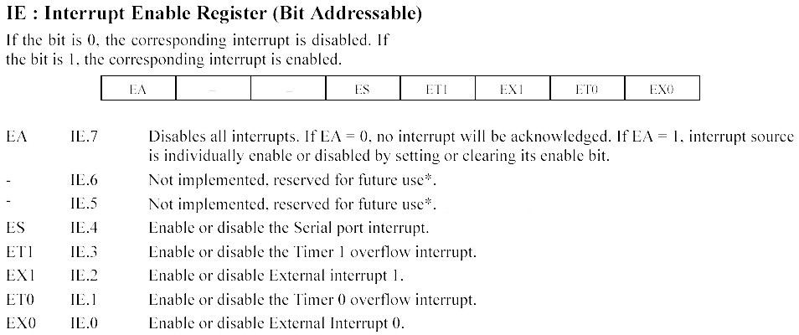
8051 makes use of two registers to deal with interrupts.
1. IE Register. This is an 8-bit register used for enabling or disabling the interrupts. The structure of IE register is shown below.

Slide 21
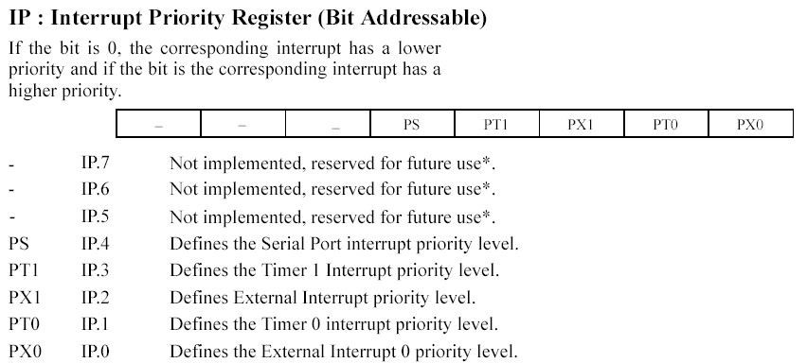
2. IP Register. This is an 8-bit register used for setting the priority of the interrupts.

Slide 22
TEXTBOOKS/REFERENCE BOOKS
TEXTBOOKS
T1 Kenneth Ayala, The 8051 Microcontroller, Cengage Learning India, 3rd Edition, Nov 2007
T2 B. Kanta Rao, Embedded Systems, PHI, 1st Edition, January 2011
T3 John Boxall, Arduino Workshop: A Hands-On Introduction with 65 Projects, No Starch Press, 1st Edition, May 2013
REFERENCE BOOKS
R1 B. Ram, Fundamentals of Microprocessors and Microcontrollers, DRP, 8th Edition, Nov 2021
R2 Massimo Banzi, Getting Started with Arduino, Make Community LLC, 3rd Edition, Jan 2015
R3 Jeremy Blum, Exploring Arduino: Tools and Techniques for Engineering Wizardry, Wiley, 1st Edition, Aug 2013
Video Links:
https://www.youtube.com/watch?v=OaaP5WIG7ro
https://www.youtube.com/watch?v=dM2swIpGk0Y
https://www.youtube.com/watch?v=DPsiTe0KAlI

